Slide 1
https://pmc.ncbi.nlm.nih.gov/articles/PMC8615531/
https://www.sciencedirect.com/topics/medicine-and-dentistry/intermittent-photic-stimulation
https://pmc.ncbi.nlm.nih.gov/articles/PMC9553892/

Slide 2
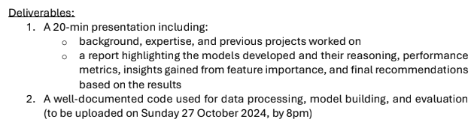
Assignment + Deliverables
Exploratory Data Analysis
Feature Engineering
Build Model
Hyperparameter Tuning
Model Evaluation
Explainability

Slide 3
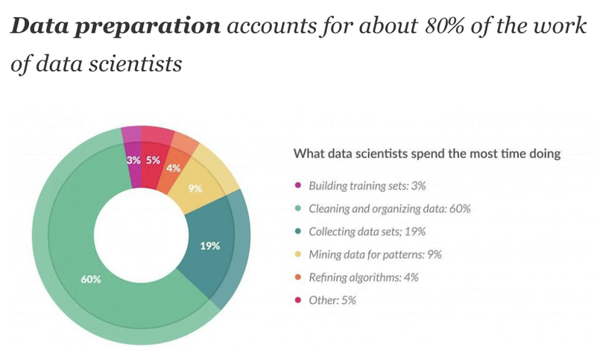
Time allocation – 80/20 rule
Effort spend:
~2 days
Not all steps done (to the needed extend)
Aim:
Give idea on how I approach
Questions that came up along the way
"Playing the whole game": A data collection and analysis exercise with Google Calendar - Scientific Figure on ResearchGate. Available from: https://www.researchgate.net/figure/The-80-20-rule-of-data-wrangling_fig2_339550606 [accessed 25 Oct 2024]

Slide 4
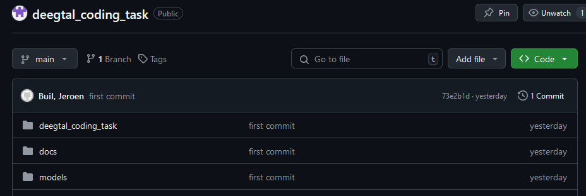
Git Repository
https://github.com/JeroenBuil/deegtal_coding_task
For this project
Stack:
Python
VSC
In reserve
Stack:
MS Azure
Databricks
SQL
Power BI
…
Packages:
MNE
SKLearn
Matplotlib
DIY

Slide 5
Exploratory Data Analysis
What are we dealing with?
Data quality?
Preprocessing?
Patterns?e
Quick Stats:
2 Groups
Unknown conditions
Unknown stimuli
5 recordings each
Recording time: ~20-25min
Fs: 250 Hz
Filtering: 125 Hz lowpass

Slide 6
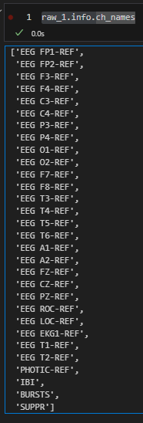
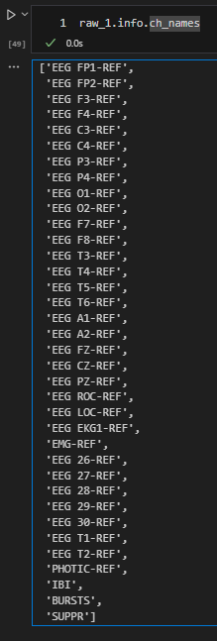
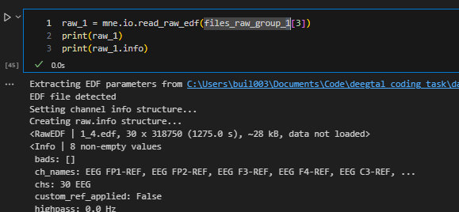
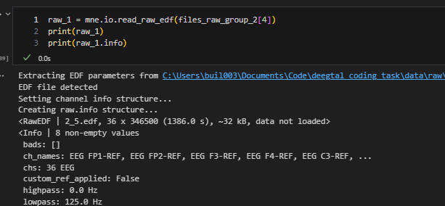
Data Quality - Consistency
Different recording methods (30ch vs 36ch)
Different experimental procedure (photic stim vs ?)

Slide 7
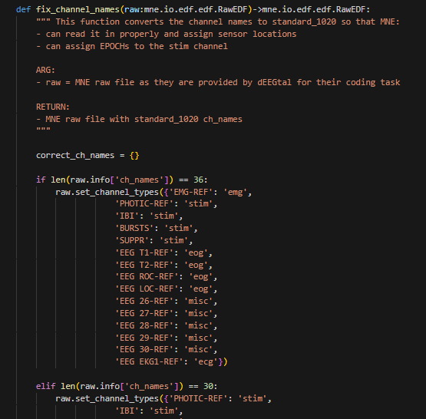
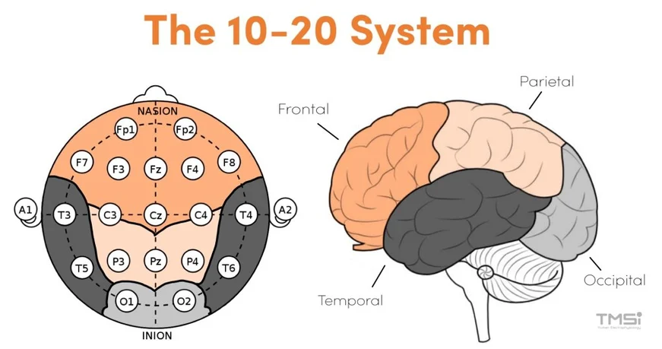
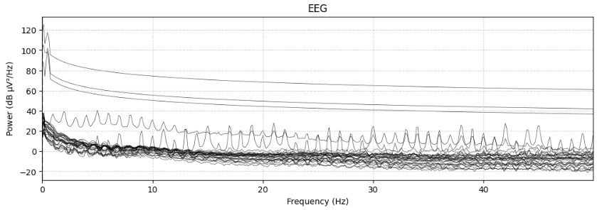
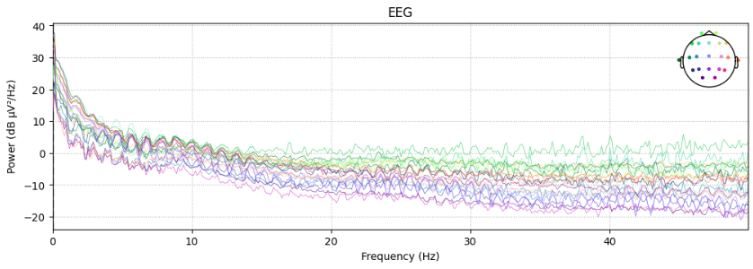
Data Quality – Ch names
Channels not in 10-20 montage naming
=> Fix + set_montage()
=> Simplifies working with MNE
https://info.tmsi.com/blog/the-10-20-system-for-eeg

Slide 8
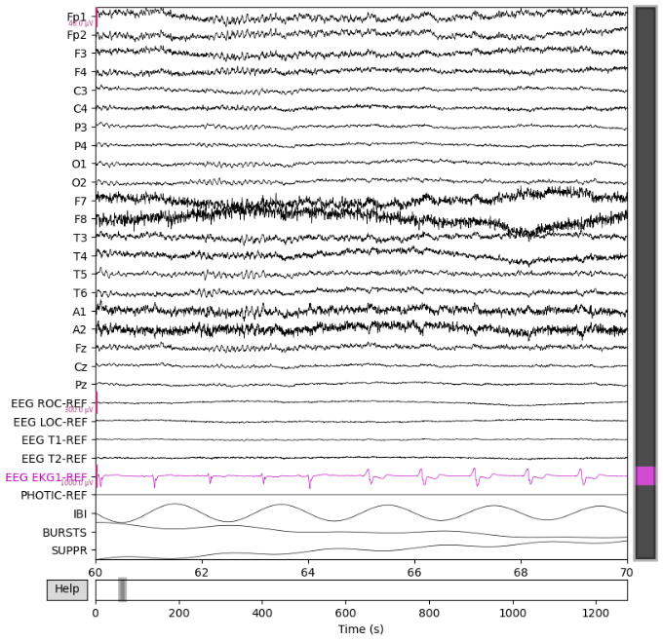
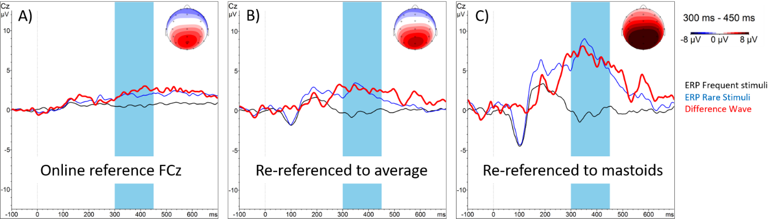
Referenced?
https://pressrelease.brainproducts.com/referencing/

Slide 9
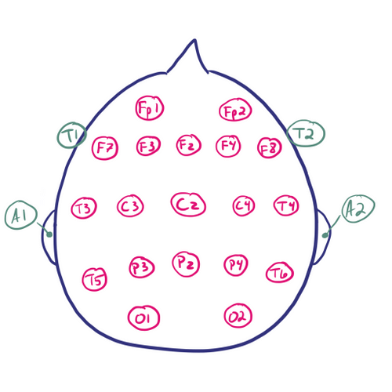
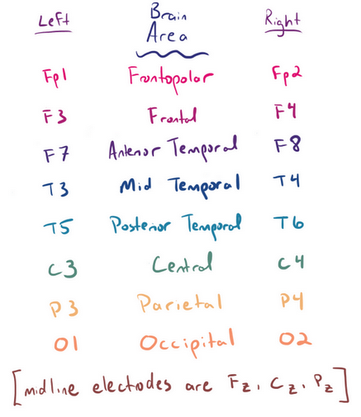
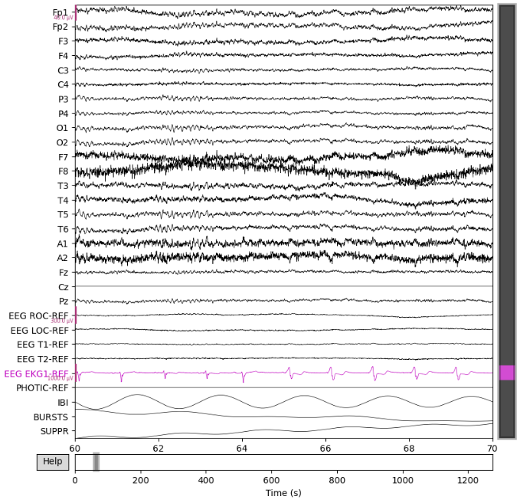
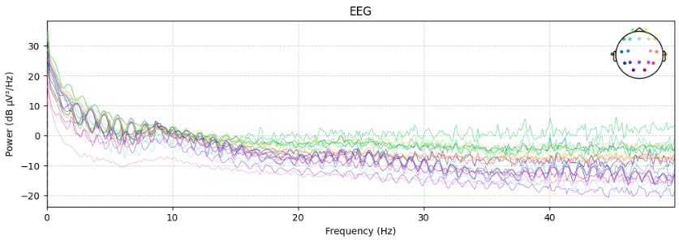
Re-referencing?
https://www.learningeeg.com/montages-and-technical-components

Slide 10
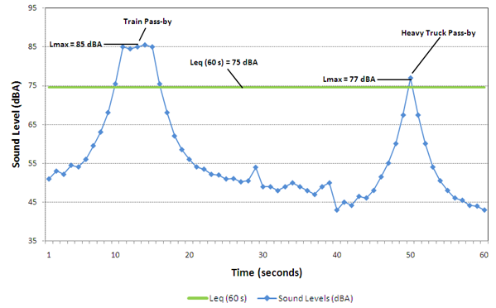
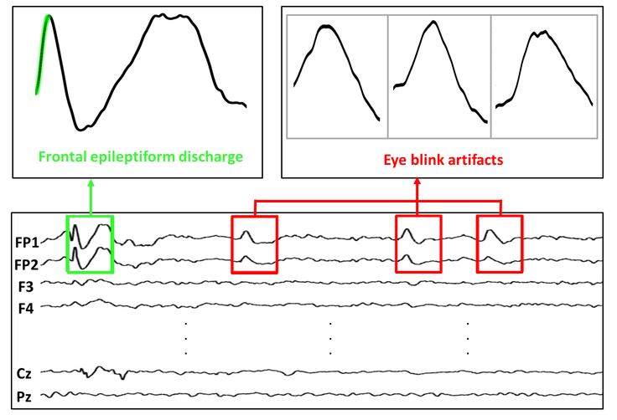
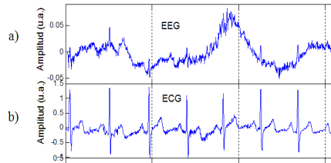
Artifacts in EEG Signals and Preprocessing
Non-biological/Environment
Biological
Powerline noise, traffic
=> bandpass + bandstop filtering
eye blinking, movement, respiration, and heartbeat
Often same freq range => grounding, linear regression methods
A Survey on Artifacts Detection Techniques for Electro-Encephalography (EEG) Signals - Scientific Figure on ResearchGate. Available from: https://www.researchgate.net/figure/a-EEG-Signals-with-Artifacts-Caused-by-b-ECG-Signals-and-C-EMG-Signals-25_fig3_281887837 [accessed 23 Oct 2024]
https://otc-cta.gc.ca/eng/railway_noise_measurement
Eye Blink Artifact Detection With Novel Optimized Multi-Dimensional Electroencephalogram Features - Scientific Figure on ResearchGate. Available from: https://www.researchgate.net/figure/Frontal-epileptiform-discharges-and-eye-blink-from-CHZU-database_fig1_353475354 [accessed 23 Oct 2024]
https://pmc.ncbi.nlm.nih.gov/articles/PMC861531/

Slide 11
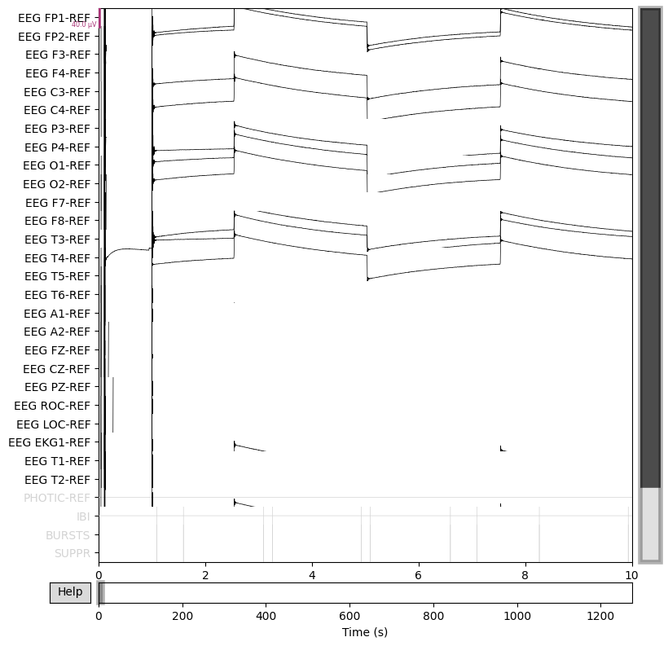
Filtering
Done:
Bandpass: 0,5-100 Hz
Notch: 60 Hz
Crop start + end of recording
Note done (but should be!)
Remove EOG + ECG artefacts
=> regression / ICA + (NN) Model

Slide 12
EDA conclusion
Crucial info is missing: Source information + Meta data
What is separating the groups? => can steer analysis + feature engineering
Where/how/by whom is recorded?
Consequence:
Unnecessary long puzzling
Risk of false comparison/assumptions between groups
No Source + Metadata == No (usable) Data

Slide 13
Feature Engineering

Slide 14
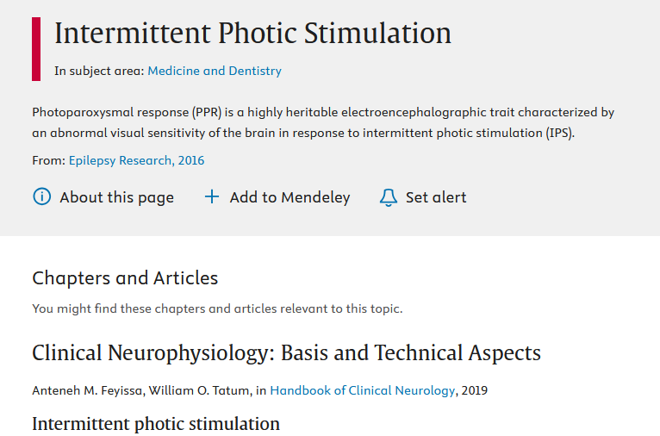
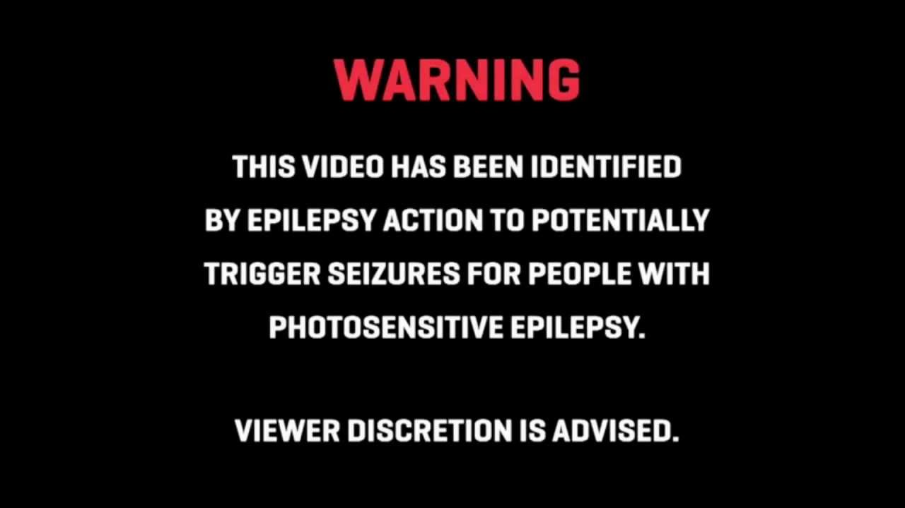
Intermittend Photic Stimulation
Pulse train found in some recordings
Unfortunately not all channels

Slide 15
No consistent stim found
Group | Recording | Channel | Mean
1 | 1 | BURSTS | 0.339228
1 | 2 | BURSTS | 0.0
1 | 3 | BURSTS | 0.0
1 | 4 | BURSTS | 0.392392
2 | 1 | BURSTS | 0.237873
2 | 2 | BURSTS | 0.0
2 | 3 | BURSTS | 0.0
2 | 4 | BURSTS | 0.0
1 | 1 | IBI | 22.108351
1 | 2 | IBI | 0.0
1 | 3 | IBI | 0.0
1 | 4 | IBI | 10.253176
2 | 1 | IBI | 1.674255
2 | 2 | IBI | 0.0
2 | 3 | IBI | 0.0
2 | 4 | IBI | 0.0
1 | 1 | PHOTIC-REF | 0.000003
1 | 2 | PHOTIC-REF | 0.000002
1 | 3 | PHOTIC-REF | 0.0
1 | 4 | PHOTIC-REF | 0.000004
2 | 1 | PHOTIC-REF | 0.000003
2 | 2 | PHOTIC-REF | 0.0
2 | 3 | PHOTIC-REF | 0.0
2 | 4 | PHOTIC-REF | 0.0
Don’t know what is done
If these recordings are comparable

Slide 16
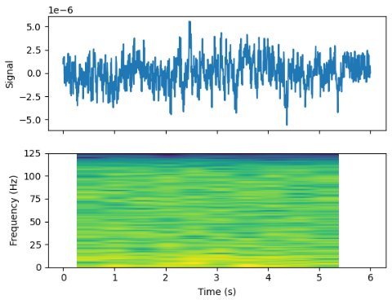
Spectogram (time-freq analysis)
Many windows = many samples!
(not as good as more subjects)

Slide 17
Where to take window?
Ideally:
Events that subjects are in same mental state
Same (lack of) ext. triggers / all in resting
HOWEVER: No epochs/annotation/description
Assumption: all subjects same mental state + physical state + same procedure
This is clearly not the case, but limited time => cutting corners
10s windows + 5 sec overlap
Nyquest: 0.5-100 Hz => >= 4 sec window

Slide 18
Build model + Model Evaluation + Explainability

Slide 19
ML Models
Unsupervised
+ fast, no pre knowledge, unbiased
- less info to train
Supervised
+ use class info to your advantage
PCA
tSNE
Clustering
Further exploration!?
XGBoost
CNN?
Preferred

Slide 20
Unsupervised
I like it: can help give indication of what happens in data
PCA => linear technique

Slide 21
XGBoost
Gradient boosted decision tree
When in doubt => Use XGBoost!
+ Not sensitive to scaling
+ High performance
+ Easy feature importance tools

Slide 22
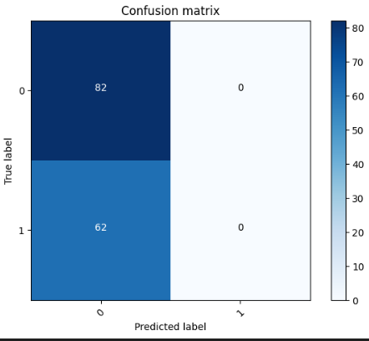
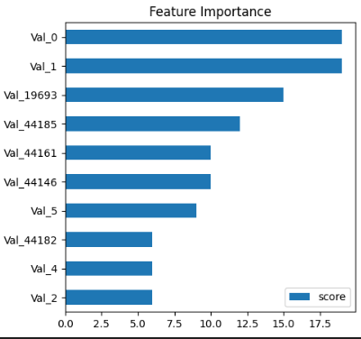
How does it do?
Needs translation to back to freq + bin

Slide 23
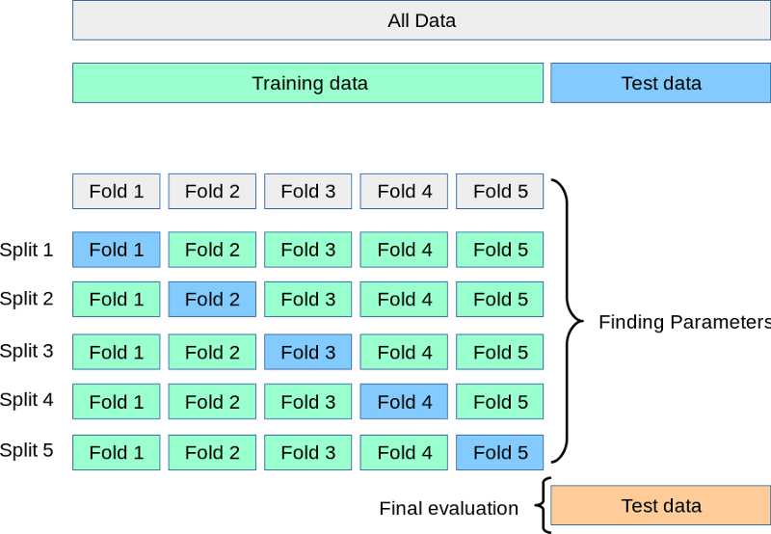

Slide 24
CNN
Why CNN =>
Lend themselves well for images
Used in literature for similar problems (REFERENCES)
Mentioned in last interview that dEEGtal using these
Easy to train
Relatively easy to XAI
RNN would lend themselves better for temporal signals
=> use electrode channel input instead of spectrogram!

Slide 25
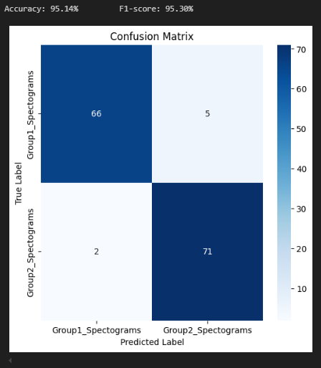
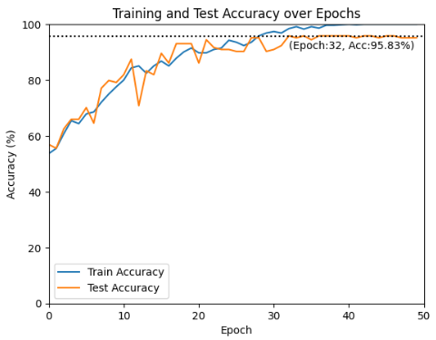
Spectograms = image => NN is the solution
Write down CNN architecture

Slide 26

Heat Map

Slide 27
Hyperparameter tuning

Slide 28
Stuff that affects performance
Filtering
Window length
Nr of windows
Spectogram:
Resolution
Freq Range
XGBoost:
Feature selection
Depth
N-times
CrossValidation
CNN:
Image transform
Architecture
Layers
Nodes
Training
Time (epochs)
Learning rate
Loss function
…

Slide 29
Next steps
More real life solution
CNN => LSTM to enable real time decoding
=> just feed in each window and find long and short term patterns

Slide 30
Next steps
The main standard about software in medical devices are:
IEC 62304. It deals with the software lifecycle, i.e. almost everything about what software engineers do.
IEC 60601-1 is applicable to embedded software in a hardware medical device,
IEC 82304-1 is applicable to standalone software, also known as Software as a Medical Device (SaMD),
IEC 81001-5-1 adds requirements about cybersecurity,
IEC 62366-1 adds requirements about man-machine interface ergonomics.

Slide 31
Conclusions

Slide 32
Conclusions
Data info crucial for design
Design is crucial for data choice
NN lend themselves good for images
Training more challenging
Explainability more challenging => heat map could help identify patterns

